Slide 1
TEXT To speech
A00651149
Haewon Byun

Slide 2
TOPICS
FUNC & BACKGROUND & ASPECTS
STEPS TO IMPLEMENT
ANDROIDMANIFEST.XML
CONTANTS & METHODS
LAB1 & LAB2

Slide 3
FUNCTIONALITY
Reads char or string information and speak in verbal language by using TTS engine

Slide 4
BACKGROUND
Started with Android 1.6(LEVEL 4)
Known as speech synthesis
TTS engine enables your android to speak text of different languages

Slide 5
ASPECTS
Supported languages:
English, German, French, Italian and Spanish
Voice and dictionary are language specific
Ex) Paris
Accent
US & UK

Slide 6
STEPS TO IMPLEMENT
1. Construct the TextToSpeech object
private TextToSpeech mTts;
import android.speech.tts.TextToSpeech;

Slide 7
STEPS TO IMPLEMENT
2. Handle initialization callback in the onInit method
implements TextToSpeech.OnInitListener
public void onInit(int status) { }
Checks status of TTS engine
Sets language

Slide 8
STEPS TO IMPLEMENT
3. Call speak() to Synthesize speech
TextToSpeech.speak(1,2,3)
1) TEXT
2) QUEMODE: FLUSH, ADD ETC
3) HASHMAP: FOR PLAYBACK
http://developer.android.com/resources/articles/tts.html

Slide 9
STEPS TO IMPLEMENT
4. Shutdown TextToSpeech in onDestroy
public void onDestroy() {
// Don't forget to shutdown!
}

Slide 10
ANDROIDMANIFEST.XML
<intent-filter>
..
<category android:name="android.intent.category.DEFAULT" /> ..
</intent-filter>

Slide 11
CONSTANTS
LANG_NOT_SUPPORTED: Denotes the language is not supported
QUEUE_ADD: Queue mode where the new entry is added at the end of the playback queue
QUEUE_FLUSH: Queue mode where all entries in the playback queue (media to be played and text to be synthesized) are dropped and replaced by the new entry.
SUCCESS: Denotes a successful operatioN

Slide 12
METHODS
setLanguage(Locale loc)
setSpeechRate(float speechRate)
stop()
shutdown()
speak(String text, int queueMode, HashMap<String, String> params)
synthesizeToFile(String text, HashMap<String, String> params, String filename)

Slide 13
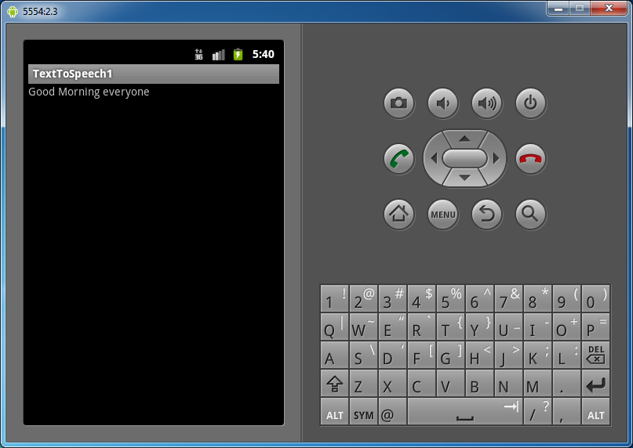
LAB1 : TextToSpeech1

Slide 14
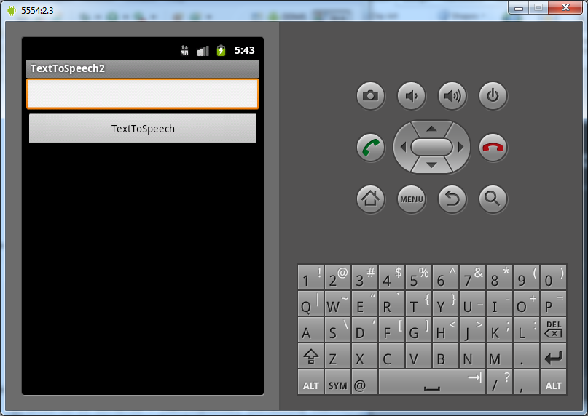
LAB2 : TextToSpeech2

Slide 15
FUNC & BACKGROUND & ASPECTS
STEPS TO IMPLEMENT
ANDROIDMANIFEST.XML
CONTANTS & METHODS
LAB1 & LAB2

Slide 16
FOR MORE INFORMATION
http://developer.android.com/reference/android/speech/tts/TextToSpeech.html
http://developer.android.com/resources/articles/tts.html

